Slide 1
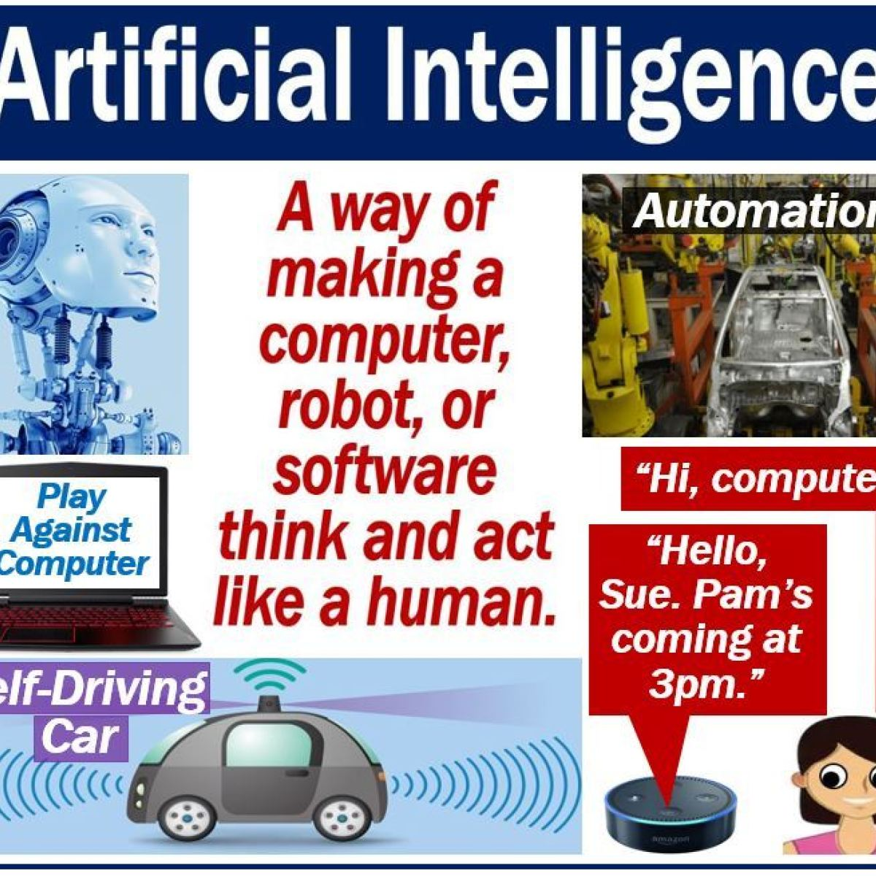
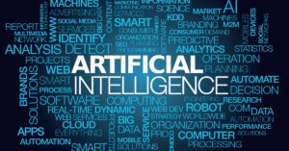
“Artificial” + “Intelligence” ”Simulation of human intelligence processes by machines, especially computer systems”

Slide 2
COURSE OBJECTIVES
CO1
Design AI solution with appropriate choice of agent architecture
CO2
Analyze and solve problems for goal based agent architecture (searching and planning algorithms).
CO3
Represent and formulate the knowledge to solve the problems using various reasoning techniques
CO4
Analyze applications of AI and understand planning & learning processes in advanced AI applications

Slide 3
Recommended Books
1. Stuart J. Russell and Peter Norvig, "Artificial Intelligence A Modern Approach “Third Edition" Pearson Education.
2. Elaine Rich and Kevin Knight "Artificial Intelligence "Third Edition
3. George F Luger “Artificial Intelligence” Low Price Edition , Pearson Education., Fourth edition
4. Davis E.Goldberg, "Genetic Algorithms: Search, Optimization and Machine Learning", Addison Wesley, N.Y., 1989.
5. Ivan Bratko "PROLOG Programming for Artificial Intelligence", Pearson Education, Third Edition.

Slide 4
MODULE 1
Reference - Chapter 1

Slide 6
Artificial intelligence (AI) is the simulation of human intelligence processes - by machines, especially computer systems
These processes include
LEARNING (the acquisition of information and rules for using the information),
REASONING (using rules to reach approximate or definite conclusions) and self-correction
Particular applications of AI include
Expert Systems, Speech Recognition And Machine Vision

Slide 7
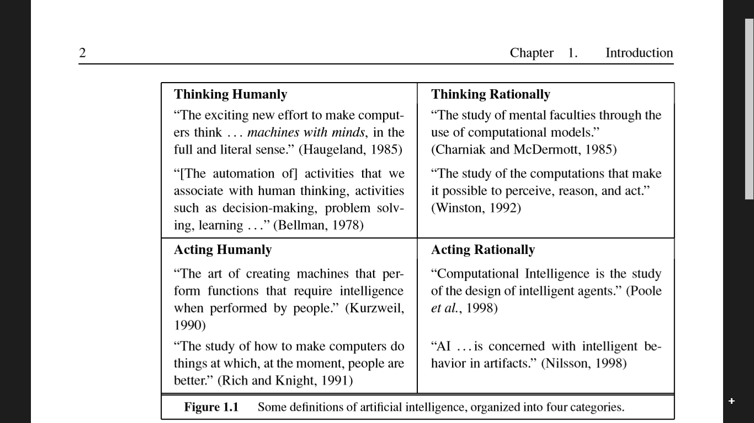

Slide 8
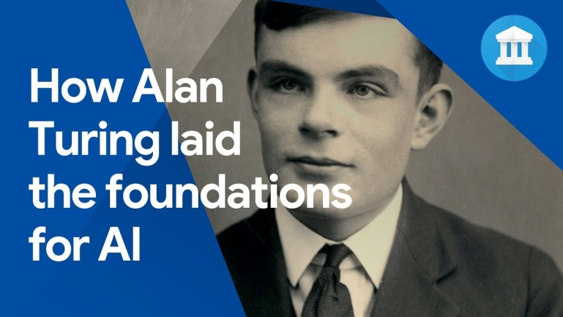
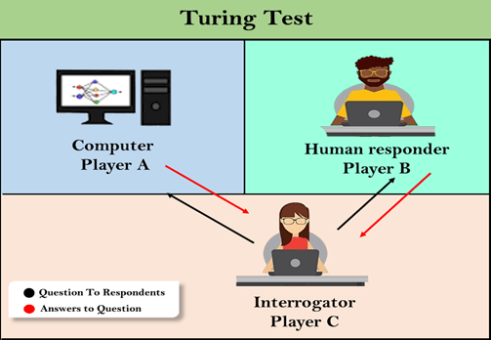
Acting humanly: The Turing Test approach
The Turing Test, proposed by Alan Turing (1950), was designed to provide a satisfactory TURING TEST operational deﬁnition of intelligence.

Slide 9
Thinking humanly: The cognitive modeling approach
If we are going to say that a given program thinks like a human, we must have some way of determining how humans think.
We need to get inside the actual workings of human minds.
There are three ways to do this:
through introspection-trying to catch our own thoughts as they go by;
through psychological experiments—observing a person in action;
through brain imaging—observing the brain in action

Slide 10
Thinking rationally: The “laws of thought” approach
“Logicist tradition within artiﬁcial intelligence hopes to build on programs to create intelligent systems”
First, it is not easy to take informal knowledge and state it in the formal terms required by logical notation
particularly when the knowledge is less than 100% certain.
Second, there is a big difference between solving a problem “in principle” and solving it in practice.

Slide 11
Acting rationally: The rational agent approach
A rational agent is one that acts so as to achieve the best outcome or, when there is uncertainty, the best expected outcome.
All the skills needed for the Turing Test also allow an agent to act rationally

Slide 12
Computer Would Need To Possess the following Capabilities:
NATURAL LANGUAGE PROCESSING to enable it to communicate successfully in English
KNOWLEDGE REPRESENTATION to store what it knows or hears
AUTOMATED REASONING to use the stored information to answer questions and to draw new conclusions
MACHINE LEARNING to adapt to new circumstances and to detect and extrapolate patterns.
COMPUTER VISION to perceive objects
ROBOTICS to manipulate objects and move about

Slide 13
Applications of AI*
AI has been dominant in various fields such as −
Gaming − AI plays crucial role in strategic games such as chess, poker, tic-tac-toe, etc., where machine can think of large number of possible positions based on heuristic knowledge.
Natural Language Processing − It is possible to interact with the computer that understands natural language spoken by humans.
Expert Systems − There are some applications which integrate machine, software, and special information to impart reasoning and advising. They provide explanation and advice to the users.
Vision Systems − These systems understand, interpret, and comprehend visual input on the computer. For example,
A spying aeroplane takes photographs, which are used to figure out spatial information or map of the areas.
Doctors use clinical expert system to diagnose the patient.
Police use computer software that can recognize the face of criminal with the stored portrait made by forensic artist.
Speech Recognition − Some intelligent systems are capable of hearing and comprehending the language in terms of sentences and their meanings while a human talks to it. It can handle different accents, slang words, noise in the background, change in human’s noise due to cold, etc.
Handwriting Recognition − The handwriting recognition software reads the text written on paper by a pen or on screen by a stylus. It can recognize the shapes of the letters and convert it into editable text.
Intelligent Robots − Robots are able to perform the tasks given by a human. They have sensors to detect physical data from the real world such as light, heat, temperature, movement, sound, bump, and pressure. They have efficient processors, multiple sensors and huge memory, to exhibit intelligence. In addition, they are capable of learning from their mistakes and they can adapt to the new environment.

Slide 14
INTELLIGENT SYSTEMS
The ability of a system to :-
calculate,
reason,
perceive relationships and analogies,
learn from experience,
store and retrieve information from memory,
solve problems,
comprehend complex ideas,
use natural language fluently,
classify, generalize, and adapt new situations.

Slide 15
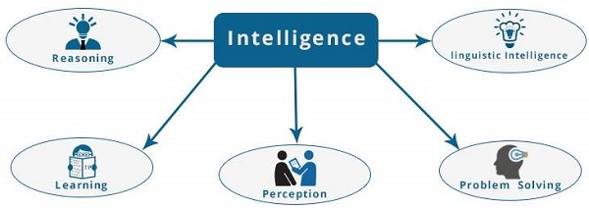
COMPONENTS OF INTELLIGENT SYSTEMS
Comprehend,Speak,Write..
Judge , Predict
Awareness,studying,practising
Sensing,Organizing, interpreting
Decision Making

Slide 16
Difference between Human and Machine Intelligence
Humans perceive by patterns whereas the machines perceive by set of rules and data.
Humans store and recall information by patterns, machines do it by searching algorithms.
For example, the number 40404040 is easy to remember, store, and recall as its pattern is simple.
Humans can figure out the complete object even if some part of it is missing or distorted; whereas the machines cannot do it correctly.

Slide 17
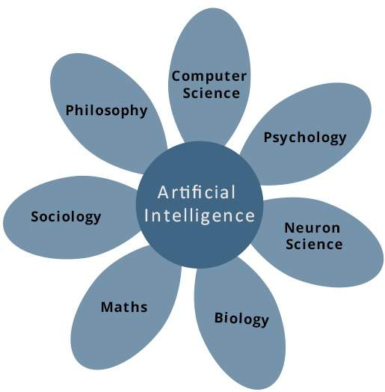
FOUNDATION OF AI
Philosophy
Mathematics
Economics
Neuroscience
Psychology
COMPUTER ENGINEERING
Linguistics

Slide 18
Philosophers (going back to 400 B.C.) made AI conceivable by considering the ideas that the mind is in some ways like a machine, that it operates on knowledge encoded in some internal language, and that thought can be used to choose what actions to take.
Mathematicians provided the tools to manipulate statements of logical certainty as well as uncertain, probabilistic statements.
They also set the groundwork for understanding computation and reasoning about algorithms.
Economists formalized the problem of making decisions that maximize the expected outcome to the decision maker.
Neuroscientists discovered some facts about how the brain works and the ways in which it is similar to and different from computers.

Slide 19
Psychologists adopted the idea that humans and animals can be considered information- processing machines.
Linguists showed that language use ﬁts into this model.
Computer engineers provided the ever-more-powerful machines that make AI applications possible.
Control theory deals with designing devices that act optimally on the basis of feedback from the environment.
Initially, the mathematical tools of control theory were quite different from AI, but the ﬁelds are coming closer together.

Slide 20
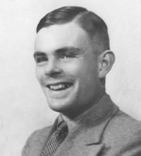
Turing Test
“HUMAN BEINGS ARE INTELLIGENT”
To be called intelligent, a machine must produce responses that are indistinguishable from those of a human
Alan Turing

Slide 21
Does AI have applications?
Autonomous planning and scheduling of tasks aboard a spacecraft
Beating Gary Kasparov in a chess match
Steering a driver-less car
Understanding language
Robotic assistants in surgery
Monitoring trade in the stock market to see if insider trading is going on

Slide 22
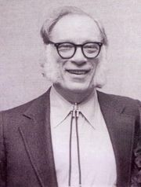
Does AI meet EE?
Robotics- the science and technology of robots, their design, manufacture, and application.
Liar! (1941)
Isaac Asimov

Slide 23
COMPONENTS OF AI
There are three types of components in AI
Hardware Components of AI
Software Components
Architectural Components

Slide 24
HARDWARE COMPONENTS OF AI
a) Pattern Matching
b) Logic Representation
c) Symbolic Processing
d) Numeric Processing
e) Problem Solving
f) Heuristic Search
g) Natural Language processing
h) Knowledge Representation
i) Expert System
j) Neural Network
k) Learning
l) Planning

Slide 25
SOFTWARE COMPONENTS
a) Machine Language
b) Assembly language
c) High level Language
d) LISP Language
e) Fourth generation Language
f) Object Oriented Language
g) Distributed Language
h) Natural Language
i) Particular Problem Solving Language

Slide 26
ARCHITECTURAL COMPONENTS
a) Uniprocessor
b) Multiprocessor
c) Special Purpose Processor
d) Array Processor
e) Vector Processor
f) Parallel Processor
g) Distributed Processor

Slide 27
Artificial intelligence can be considered under a number of headings:
Search (includes Game Playing).
Representing Knowledge and Reasoning with it.
Planning.
Learning.
Natural language processing.
Expert Systems.
Interacting with the Environment (e.g. Vision, Speech recognition, Robotics)

Slide 28
History of Artificial Intelligence(Pg No 16-28)
The gestation of artiﬁcial intelligence (1943–1955)
The birth of artiﬁcial intelligence (1956)
Early enthusiasm, great expectations (1952–1969)
A dose of reality (1966–1973)
Knowledge-based systems: The key to power(1969–1979)
AI becomes an industry (1980–present)
The return of neural networks (1986–present)
AI adopts the scientiﬁc method (1987–present)
The emergence of intelligent agents (1995–present)
The availability of very large data sets (2001–present)

Slide 29
Year | Milestone / Innovation
1923 | Karel Čapek play named “Rossum's Universal Robots” (RUR) opens in London, first use of the word "robot" in English.
1943 | Foundations for neural networks laid.
1945 | Isaac Asimov, a Columbia University alumni, coined the term Robotics.
1950 | Alan Turing introduced Turing Test for evaluation of intelligence and published Computing Machinery and Intelligence. Claude Shannon published Detailed Analysis of Chess Playing as a search.
1956 | John McCarthy coined the term Artificial Intelligence. Demonstration of the first running AI program at Carnegie Mellon University.
1958 | John McCarthy invents LISP programming language for AI.
1964 | Danny Bobrow's dissertation at MIT showed that computers can understand natural language well enough to solve algebra word problems correctly.
1965 | Joseph Weizenbaum at MIT built ELIZA, an interactive problem that carries on a dialogue in English.
1969 | Scientists at Stanford Research Institute Developed Shakey, a robot, equipped with locomotion, perception, and problem solving.
1973 | The Assembly Robotics group at Edinburgh University built Freddy, the Famous Scottish Robot, capable of using vision to locate and assemble models.
1979 | The first computer-controlled autonomous vehicle, Stanford Cart, was built.
1985 | Harold Cohen created and demonstrated the drawing program, Aaron.
1990 | Major advances in all areas of AI − Significant demonstrations in machine learning,Case-based reasoning,Multi-agent planning,Scheduling Data mining, Web Crawler,natural language understanding and translation,Vision, Virtual Reality,Games
1997 | The Deep Blue Chess Program beats the then world chess champion, Garry Kasparov.
2000 | Interactive robot pets become commercially available. MIT displays Kismet, a robot with a face that expresses emotions. The robot Nomad explores remote regions of Antarctica and locates meteorites.

Slide 30
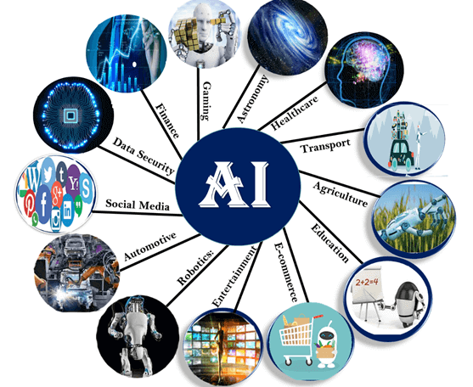

Slide 31
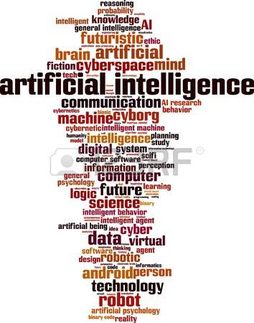

Slide 32
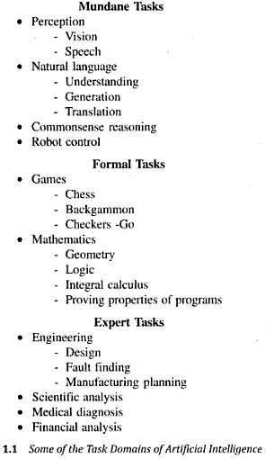
AI Problems (Rich & Knight)

Slide 33
AI Techniques
Technique is a method that exploits knowledge that should be represented in a way that:
Knowledge captures generalizations.
Understood by people who must provide it
Can be easily modified to correct errors and reflect changes.
Can be used in almost all situations
Able to narrow down the possibilities on it s own knowledge

Slide 34
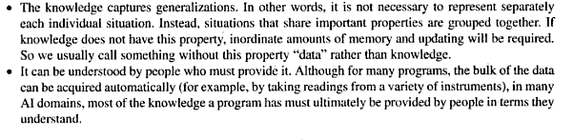

AI Techniques

Slide 35
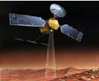
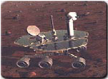
AI Applications
Autonomous Planning & Scheduling:
Autonomous rovers.

Slide 36
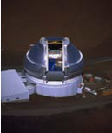
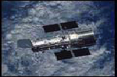
AI Applications
Autonomous Planning & Scheduling:
Telescope scheduling

Slide 37



AI Applications
Autonomous Planning & Scheduling:
Analysis of data:

Slide 38
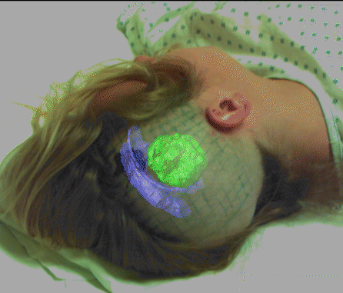

AI Applications
Medicine:
Image guided surgery

Slide 39




AI Applications
Medicine:
Image analysis and enhancement

Slide 40

AI Applications
Transportation:
Autonomous vehicle control:

Slide 41

AI Applications
Transportation:
Pedestrian detection:

Slide 42
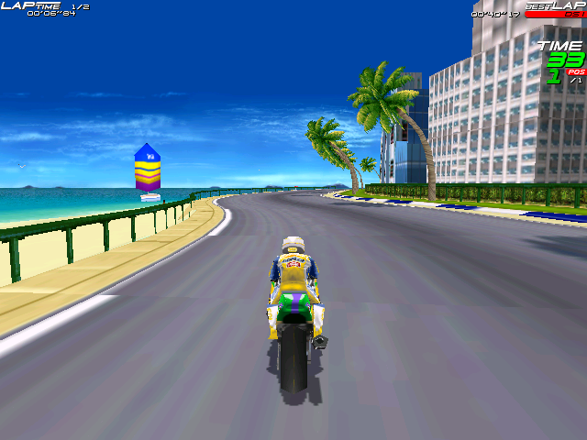
AI Applications
Games:

Slide 43
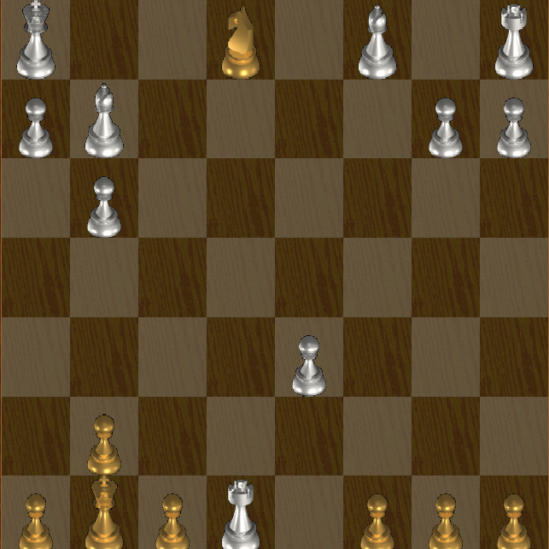
AI Applications
Games:

Slide 44
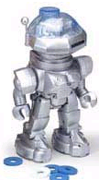

AI Applications
Robotic toys:

Slide 45
AI Applications
Other application areas:
Bioinformatics:
Gene expression data analysis
Prediction of protein structure
Text classification, document sorting:
Web pages, e-mails
Articles in the news
Video, image classification
Music composition, picture drawing
Natural Language Processing .
Perception.

Slide 46
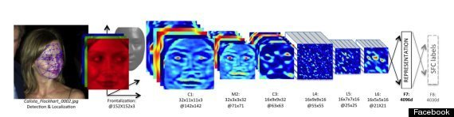
AI in daily life
Commuting ( Google Maps)
Email (Spam)
Plagiarism (Turnitin)
Social Networking (FB ( ? ),Snapchat, Instagram
Online Shopping-Recommendations

Slide 47
Things AI cannot do (Yet)
Conversational interfaces—ask Siri something off script, and it breaks down
Automated scientific discovery
Automated medical diagnosis
Automated scene comprehension for blind people
Cannot write software
Safe and reliable driverless cars
Computers cant Think/Understand/
Creative writing
AI cannot exercise free will

